Slide 1

DriverPass System Analysis
[Luis Navarro]

Slide 2

System Requirements
Functional Requirement 1: Allow customers to easily book, change, or cancel a 2-hour driving lesson online.
Functional Requirement 2: Automatically update the system whenever the DMV changes its rules or sample test questions.
Nonfunctional Requirement 1: Ensure the system runs smoothly over a secure cloud environment, accessible from any device.
Nonfunctional Requirement 2: Create detailed, downloadable reports to track daily business operations and student progress.
Notes:
Liam, to ensure the new DriverPass system solves your current scheduling problems, we established several key requirements. First, we focused on functionality. The system will feature a self-service portal, allowing your students to book or adjust their 2-hour driving lessons directly online. This meets your need to replace the manual, paper-based scheduling system that takes up so much of your secretary's time. We also built in an automated link to the DMV, ensuring your practice tests are always up-to-date with the latest state rules without you having to manually check for changes.
On the technical side, we prioritized accessibility and reporting. The entire platform will be securely hosted in the cloud, meaning you, your staff, and your students can access it from anywhere using a phone or computer. Finally, we know you need to keep a close eye on the business, so the system is designed to generate easily downloadable activity reports, allowing you to track exactly how the fleet is being used and how students are progressing

Slide 3
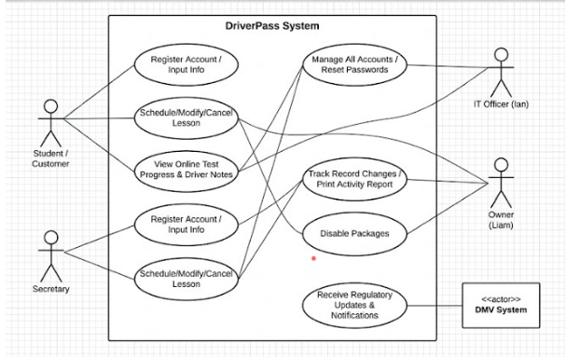
Use Case Diagram
[Insert your use case diagram here.]
Notes:
Liam, the diagram on this slide acts as a high-level map showing exactly who interacts with the new DriverPass system and what tasks they can accomplish within it.
On the left side, we have the people who will be using the system on a daily basis: your students, your secretary, and your driving instructors. Students and the secretary can easily manage scheduling and cancellations online. This directly solves the bottleneck you've been experiencing with manual, paper-based booking. Your instructors also have a dedicated space to log lesson timestamps and add direct feedback on student progress.
On the right side, we mapped out the administrative and business side. This includes you, securely downloading operational reports to keep a pulse on the business, and your IT lead, Ian, who can manage account security and password resets. Finally, we included the state DMV as an external connection. This ensures that whenever the state updates testing rules or questions, your system's practice tests are automatically updated as well. This entire setup guarantees that everyone has the exact tools they need to operate smoothly and help your students succeed.

Slide 4
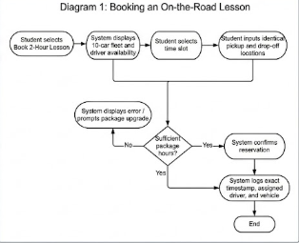
Activity Diagram
[Insert one of your activity diagrams here.]
Notes:
Liam, this slide breaks down the step-by-step journey a student takes when they want to book a driving lesson. We wanted to make sure this process was as seamless as possible to take the burden off your secretary.
When a student clicks to book a two-hour lesson, the system immediately looks at the real-time availability of your instructors and your specific fleet of 10 cars. Once the student picks an open time slot, the system prompts them to enter their exact pickup and drop-off locations, ensuring your drivers have all the details they need upfront.
Before the booking is finalized, the system automatically does a quick check to verify that the student still has enough driving hours left in their purchased training package. If everything looks good, the reservation is confirmed. Behind the scenes, the system instantly logs the exact time, the assigned instructor, and the vehicle. This completely automates your scheduling, prevents any accidental double-bookings, and enforces your package limits without your staff having to lift a finger.

Slide 5
Security
Secure Data Storage: Isolated protection for sensitive student information, including addresses and credit card details.
Activity Tracking: Permanent, automated logs that record exactly who makes, changes, or cancels a reservation.
Master Administrative Control: Centralized access for your IT officer to instantly manage, reset, or block user accounts.
Automated Protections: Cloud-based background backups and built-in security protocols to prevent data loss
Notes:
Liam, keeping your students' data safe and your business running securely is a top priority in this design.
First, the system is built to strictly protect sensitive information. When a student registers, their personal details and credit card numbers are locked down in a secure layer, completely isolated from general access. We also built in accountability for the daily operations. Every time a lesson is booked, changed, or canceled, the system creates a permanent record of who made that change and when. If there is ever a scheduling dispute, you will have a clear paper trail.
We also made sure your IT officer, Ian, has master control. If an employee leaves the company, Ian can instantly block their access to the system. Finally, because the whole platform is hosted in the cloud, it automatically handles background backups and security updates, meaning you don't have to worry about losing your data if a computer crashes in the office.

Slide 6
System Limitations
Fixed Fleet Capacity: The scheduling system is hard-coded to support a maximum of 10 active training vehicles at any given time.
Package Creation: While existing training packages can be disabled, adding entirely new package structures in the future will require developer assistance.
Notes:
Liam, to be completely transparent, there are a couple of boundaries we need to keep in mind for this initial launch of the system.
First, we built the scheduling logic around your actual, physical resources. The system is strictly limited to managing exactly 10 training vehicles. It will actively prevent any bookings that exceed that 10-car limit, which is great for avoiding double-bookings, but it does mean the software would need an update if you ever decide to buy an 11th car.
Second, we built in the flexibility for you to easily turn off any of the three current training packages if you stop offering them. However, we did not include a 'do-it-yourself' builder for creating brand new packages. If your business expands and you want to offer a completely new type of training course, you will need to bring a developer back in to code that new module into the system.

